Slide 1
PowerShell as a Scripting Language
Corbin Osman – ENTD261: Scripting Languages for the Administrator

Slide 2
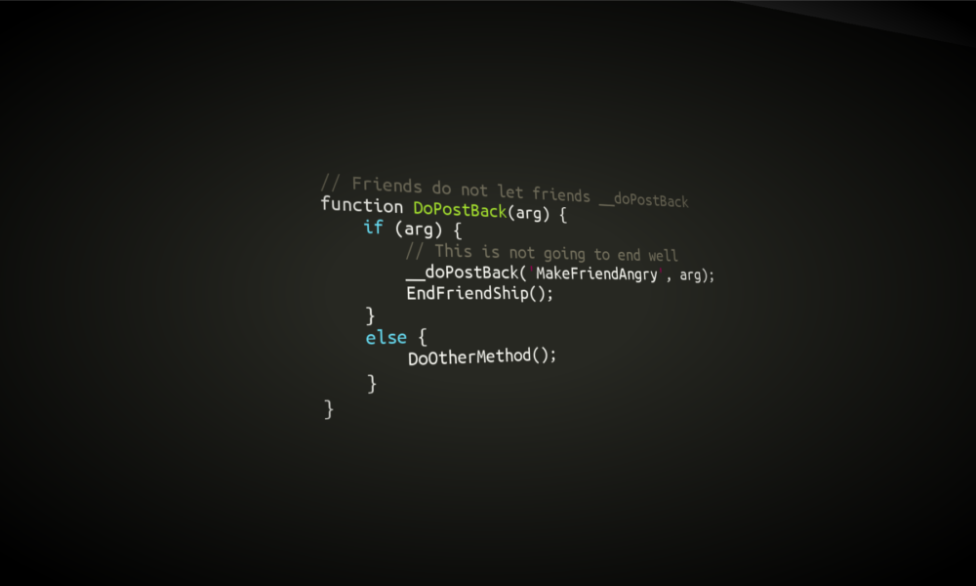
The Role of Scripting in System Administration
System administrators have many tasks and responsibilities in their roles and jobs. Scripting offers administrators various tools and functions that allow for easier completion of their role.
Manage and run scripts across multiple systems simultaneously
Automate routine and repetitive tasks
Offer ease of mind when using working scripts across multiple systems and programs
Save time with reusable scripts

Slide 3

How to Apply Security Measures in Scripting
As with all areas of technology, it is important that security measures are in place to protect and secure scripts.
Grant modification and viewing access of scripts only to those who need authorization
Secure scripting files and programs in locations that are inaccessible to unauthorized users
Disable unauthorized user access to scripting and command software such as PowerShell
Configure execution policies, such as bypass or restricted, to set the permissible level of script execution

Slide 4
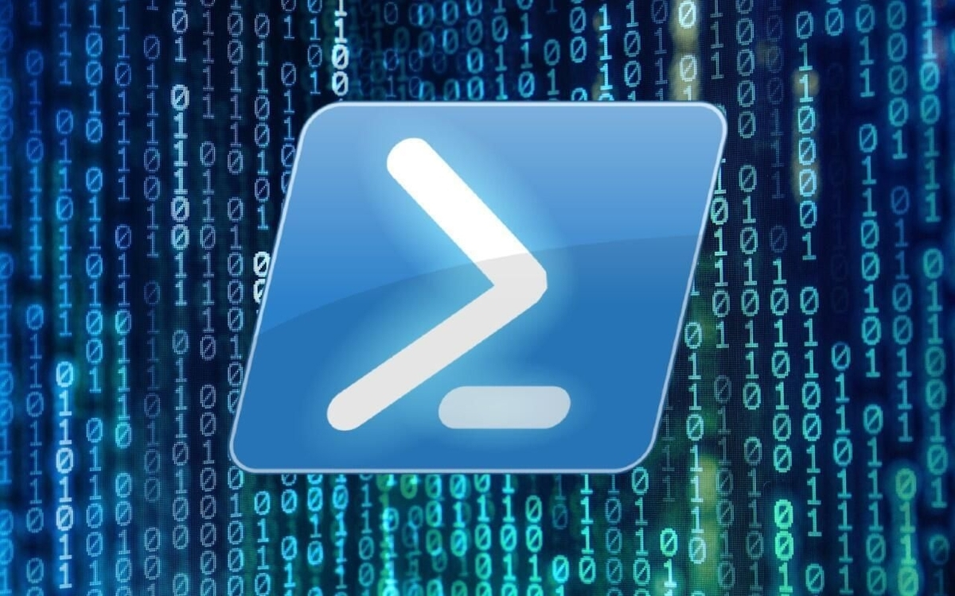
What is PowerShell?
PowerShell is a command-line interface used for the configuration and management of devices, systems, and user accounts.
PowerShell allows for the use of commands and scripts to automate tasks, make changes to accounts and system settings, and configure policies and permissions.
PowerShell is available across multiple operating systems such as Windows, MacOS, and Linux.

Slide 5

Can PowerShell Run in Other Platforms?
As mentioned in the previous slide, PowerShell is supported across other platforms and operating systems.
With PowerShell being open-source, it is now available across the main three platforms of Windows, MacOS, and Linux.
With cross-platform compatibility, administrators and users can run scripts and commands across different operating systems without needing to make necessary modifications to code.

Slide 6
How to Assign Variables in PowerShell
Variables can be assigned in PowerShell as values, names, paths, and more.
Variables begin with a $ sign and are in text format, such as $variable, $value, $path.
Microsoft shares three types of variables that can be assigned and used in PowerShell (Michaeltlombardi):
User-Created Variables: Created and maintained by the user while the PowerShell command prompt is in use
Automatic Variables: Created and maintained by PowerShell with set values
Preference Variables: Created by PowerShell and can be modified by users to set their own values

Slide 7
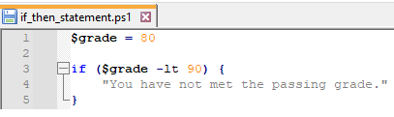
How to Use If-Then in PowerShell
If-then statements are conditional statements, resulting in an output or functions if a certain requirement is met. If the requirement is not met, the script will continue without running the conditional statement.
A simple if-then example involves a variable, named $grade, which is assigned a value of 80. Using the variable in an if-the statement as seen to the right, PowerShell can check if the input value meets the if-then requirements.
In this instance, the $grade value does not meet the minimum value requirement, resulting in the if-then statement running.

Slide 8
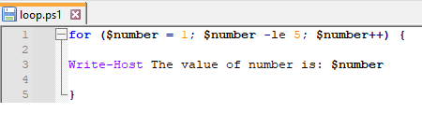
How to Use Loops in PowerShell
A loop involves a statement that will continue to repeatedly run until a certain requirement is met.
A simple loop example involves a variable, named $number, which is assigned a value of 1. The loop statement checks the value of the variable $number, and if it is less than the value of 10, it adds one to the value of $number. It will then print the sentence showing the value of $number and will then repeat as the value is less than 10.
This loop will continue to run until the value of $number reaches 10, and each iteration of the loop will result in the value of $number increasing.

Slide 9
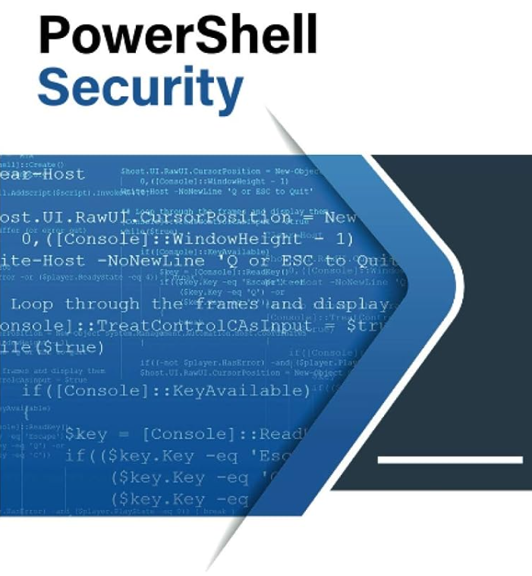
How to Apply Security on PowerShell Scripts
There are various ways administrators can secure PowerShell scripts to protect them from modification, deletion, or unauthorized running.
Prevent execution on systems where users have no need to run PowerShell scripts and commands.
Utilize certificate services to allow only certain users access to PowerShell scripts
Assign permissions to which users can access, modify, and read scripts through use of Group Policy Objects

Slide 10

How to Use PowerShell Scripting in Everyday Tasks
As mentioned previously, scripting offers administrators various tools and functions that allow for easier completion of their role. Following are various ways scripts can be used to complete everyday tasks:
Automate routine daily tasks such as starting systems or servers and recording logs at certain times of day
Add, manage and remove users from groups and specific permissions
Routinely create backups of data (daily, weekly, etc.) and store them in select locations
Automatically install needed software and programs on a new device remotely via script use

Slide 11
References
Michaeltlombardi, Sdwheeler. (2022, September 19). about Variables - PowerShell. Microsoft Learn. https://learn.microsoft.com/en-us/powershell/module/microsoft.powershell.core/about/about_variables?view=powershell-7.3

